Slide 1
On the role of hypothetical estimand strategies in clinical trials
Caught between a rock and a hard place
Frank Bretz, Mouna Akacha
July 23rd, 2021

Slide 2
Disclaimer
The slides reflect our current thinking rather than offering specific solutions or advice at this point. They are meant to facilitate discussions and exchange of experience.

Slide 3
Outline
Brief reminder about the ‘estimand framework’ (ICH E9 addendum)
Hypothetical strategies and the need for precise definitions
Examples of hypothetical scenarios
Conclusions

Slide 4
Outline
Brief reminder about the ‘estimand framework’
Hypothetical strategies and the need for precise definitions
Examples of hypothetical scenarios
Conclusions

Slide 5

ICH E9(R1)
Estimand
A precise description of the treatment effect reflecting the clinical question posed by the trial objective.

Slide 6
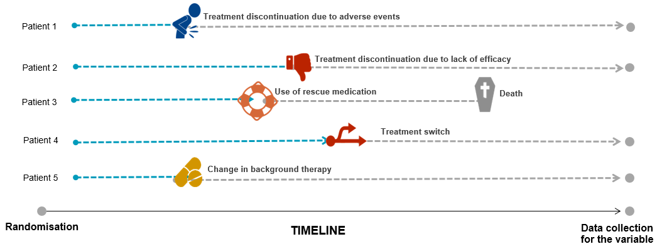
Patient journeys and intercurrent events
An intercurrent event is an event that occurs after randomization/treatment initiation and either precludes observation of the variable or affects its interpretation.

Slide 7
Strategies to address intercurrent events
ICH E9(R1) discusses five strategies to address intercurrent events
Example: ‘Intake of additional medication’
Treatment policy: Treatment effect regardless of the intercurrent event
e.g. ‘Drug, plus additional medication as needed’ vs. ‘Placebo, plus additional medication as needed’
Hypothetical: Treatment effect if the intercurrent event did not occur
e.g. ‘Effect of Drug vs Placebo if additional medication had not been taken’
Composite: Occurrence of intercurrent event included in the endpoint definition
e.g. ‘Intake of additional medication is considered a treatment failure’
Principal Stratum
While on Treatment

Slide 8
Outline
Brief reminder about the ‘estimand framework’
Hypothetical strategies and the need for precise definitions
Examples of hypothetical scenarios
Conclusions

Slide 9
Hypothetical strategies – ‘What if...’
According to ICH E9(R1):
“A scenario is envisaged in which the intercurrent event would not occur: the value of the variable to reflect the clinical question of interest is the value which the variable would have taken in the hypothetical scenario defined.
A wide variety of hypothetical scenarios can be envisaged, but some scenarios are likely to be of more clinical or regulatory interest than others.”

Slide 10
Broad range hypothetical scenarios can be considered
The hypothetical scenario ‘if additional medication had not been taken’ is not precise enough
What would the treatment effect be, had additional medication not been made available?
May be plausible to ask this question if additional medication was optional
Presumably patients would have more severe symptoms if additional medication was withheld
What would the treatment effect be, had patients not needed additional medication and behaved like other patients who did not take additional medication?
Not clear what plausible scenario would lead to ‘patients not needing additional medication’
Not clear why patients who needed additional medication would behave like patients not needing additional medication
What would the treatment effect be, had patients not needed additional medication and behaved like placebo patients?
Not clear what plausible scenario would lead to ‘patients not needing additional medication’
Not clear why patients who needed additional medication would behave like placebo patients thereafter

Slide 11
Broad range hypothetical scenarios can be considered
The hypothetical scenario ‘if additional medication had not been taken?’ is not precise enough
What would the treatment effect be, had additional medication not been made available?
May be plausible to ask this question if additional medication was optional
Presumably patients would have more severe symptoms if additional medication was withheld
What would the treatment effect be, had patients not needed additional medication and behaved like other patients who did not take additional medication?
Not clear what plausible scenario would lead to ‘patients not needing additional medication’
Not clear why patients who needed additional medication would behave like patients not needing additional medication
What would the treatment effect be, had patients not needed additional medication and behaved like placebo patients?
Not clear what plausible scenario would lead to ‘patients not needing additional medication’
Not clear why patients who needed additional medication would behave like placebo patients thereafter
Importantly, speaking of ‘THE hypothetical’ leaves too much room for ambiguity → a precise language is required to explain how the hypothetical scenario is realized
Numerous hypothetical estimands can be formulated – some are more useful and clinically plausible than others

Slide 12
Outline
Brief reminder about the ‘estimand framework’
Hypothetical strategies and the need for precise definitions
Examples of hypothetical scenarios
Conclusions

Slide 13
How to ensure the relevance of a hypothetical scenario?
In the following, we use several examples to delineate different hypothetical scenarios, from less to more clinically relevant
Severe pain indication
Nasal polyp indication
Rare and progressive renal indication, no approved therapies
Treatment switching in a placebo-controlled trial
Kidney transplantation in dialysis patients
Disclaimer: Examples have been simplified for the purpose of this presentation

Slide 14
1. Severe pain indication
Phase III trial investigating a new drug in patients with severe pain
Short-term use of rescue medication (the intercurrent event) is allowed for ethical reasons, otherwise patients may commit suicide during intense pain attacks
What is the (scientific / clinical / regulatory) relevance of the following two hypothetical scenarios?
Treatment effect is of interest had patients not needed rescue medication
Is it realistic to assume that the patients’ behavior can be changed accordingly?
Treatment effect is of interest had rescue medication not been made available to patients
Would it be conceivable to run such a trial in practice?
Both hypothetical scenarios are different, but neither of them is of clinical relevance in this particular setting

Slide 15
1. Severe pain indication
Phase III trial investigating a new drug in patients with severe pain
Short-term use of rescue medication (the intercurrent event) is allowed for ethical reasons, otherwise patients may commit suicide during intense pain attacks
What is the (scientific / clinical / regulatory) relevance of the following two hypothetical scenarios?
Treatment effect is of interest had patients not needed rescue medication
Is it realistic to assume that the patients’ behavior can be changed accordingly?
Treatment effect is of interest had rescue medication not been made available to patients
Would it be conceivable to run such a trial in practice?
Both hypothetical scenarios are very different, but neither of them is of clinical relevance in this particular setting
Importantly, short-term use of rescue medication is not optional: It will be a key part of a future treatment strategy in conjunction with the new drug and withholding it from patients is unreasonable.
But what are the implications for the approval and labelling process? Will it be for ‘drug’, or for ‘drug, plus rescue medication as needed’? If the latter, will it be for a specific rescue medication and what happens if after some time it is no longer part of clinical practice?

Slide 16
2. Nasal polyp indication
Surgery is an intercurrent event and the question is whether a hypothetical estimand (‘if surgery had not been made available’) is clinically meaningful
While surgery is common clinical practice, arguing that a hypothetical estimand is therefore neither of clinical nor of regulatory interest leaves room for ambiguity
What if the decision to perform surgery is optional, for example:
at the discretion of the investigator?
due to regional differences?
comorbidities limit some patients to have the surgery?

Slide 17
2. Nasal polyp indication
Surgery is an intercurrent event and the question is whether a hypothetical estimand (‘if surgery had not been made available’) is clinically meaningful
While surgery is common clinical practice, arguing that a hypothetical estimand is therefore neither of clinical nor of regulatory interest leaves room for ambiguity
What if the decision to perform surgery is optional, for example:
at the discretion of the investigator?
due to regional differences?
comorbidities limit some patients to have the surgery?
Need for surgery may indicate that the drug is ineffective, in which case it should be part of the outcome definition
Use of a composite strategy seems reasonable (e.g., by assigning surgery the worst outcome on an existing ordinal scale)
Importantly, a composite strategy is reasonable for clinical reasons, not because a hypothetical strategy is unreasonable

Slide 18
3. Rare and progressive renal indication, no approved therapies
Rare renal disease leading to ~50% patients progressing to kidney failure
Primary endpoint of proteinuria assessed in a placebo-controlled trial
Due to lack of approved treatments and despite increased infection risk, patients are often treated with immunosuppressants to reduce proteinuria with the hope to improve kidney function
In a placebo-controlled setting, immunosuppressants may be prescribed as rescue during the trial
However, such therapies are not desired as part of a future treatment strategy, if the new treatment is shown to be beneficial
Conclusion: It seems reasonable to evaluate the treatment effect in a hypothetical scenario where immunosuppressants were not made available

Slide 19
4. Treatment switching in a placebo-controlled trial
Randomized, double-blind, placebo-controlled Phase III study
Compare a new drug versus placebo in the treatment of an inflammatory disease
Clinical measurement of interest: continuous symptom score at week 52
Week 16
Week 52
Patients are allowed to switch to rescue therapy (essentially new drug itself) after week 16 if symptoms are not controlled
No deterministic rule for switching to rescue
Many placebo patients are expected to switch to new drug after week 16
Placebo
Drug

Slide 20
4. Treatment switching in a placebo-controlled trial
Randomized, double-blind, placebo-controlled Phase III study
Compare a new drug versus placebo in the treatment of an inflammatory disease
Clinical measurement of interest: continuous symptom score at week 52
What is the role of hypothetical estimands in placebo-controlled trials?
The fact that we are conducting a placebo-controlled trial suggests that we want to tease out the ‘pure treatment effect’ of drug versus placebo
If administration of placebo is questionable for ethical reasons, patients have to be offered the possibility to switch to an alternative treatment option or use rescue
In such settings, it is conceivable that a hypothetical estimand is of regulatory interest
If a ‘pure treatment effect’ is not of interest, then the design seems to be inappropriate
→ if real clinical practice was of interest, wouldn't we consider running more pragmatic trials and limit the use of placebo-controlled trials?
Week 16
Week 52
Patients are allowed to switch to rescue therapy (essentially new drug itself) after week 16 if symptoms are not controlled
No deterministic rule for switching to rescue
Many placebo patients are expected to switch to new drug after week 16
Placebo
Drug

Slide 21
5. Kidney transplant in dialysis patients
Chronic kidney disease where patients need dialysis
Consider a two-year study to either compare two types of dialysis on morbidity and mortality or investigate the effect of a drug intended to reduce the frequency or number of dialysis sessions
A minority of patients will be eligible for a renal transplantation during this period
this is neither due to treatment toxicity nor a trial endpoint
it would not be possible to anticipate in advance who will get a transplant and when a donor kidney will be available
Hence a transplant can be considered a randomly occurring intercurrent event and the patient would be withdrawn from the study
It could well be of interest to ask the question of what would have been the outcome of interest in the arms had the patients not been withdrawn for transplant

Slide 22
Summary of examples
Credit to Melanie Wright
Intercurrent event (IE)... | Example | Strategy
... is part of a future treatment strategy | Short term pain medication in severe pain indication | Treatment policy: The IE is part of the treatment strategy
... is outcome-related (possibly even being an efficacy endpoint in its own right) | Surgery in nasal polyp indication | Composite strategy: Assign worst outcome on an existing ordinal scale
... is a medication or procedure which is necessary to offer for ethical reasons, but is not desired as part of a future treatment strategy | Off-label rescue medication in rare renal disease | Hypothetical strategy: A scenario is envisaged to assess the pure treatment effect of the new drug
 | Treatment switch if symptoms are not controlled
... prevents the outcome being observed, but is expected to occur randomly and is not thought to be impacted by the treatment | Kidney transplant in dialysis patients | Hypothetical strategy: A scenario is envisaged in which the IE would not occur

Slide 23
Outline
Brief reminder about the ‘estimand framework’
Hypothetical strategies and the need for precise definitions
Examples of hypothetical strategies
Conclusions

Slide 24
Relevance of hypothetical scenarios
ICH E9(R1) acknowledges that “some scenarios are likely to be of more clinical or regulatory interest than others”
While it does not provide guidance on assessing the relevance of hypothetical scenarios, it suggests a two-step approach:
Hypothetical scenarios that cannot possibly occur in clinical practice are likely irrelevant and should be avoided for a primary estimand in a confirmatory trial
For example, it may not be reasonable to hypothesize a scenario where patients fully adhere to their treatment notwithstanding serious adverse events
Otherwise, a hypothetical strategy might be of interest, but...
clinical plausibility remains to be justified in each case
statistically valid and robust analysis approaches must be ensured

Slide 25
Conclusions
We argue that
the class of hypothetical estimands is very broad and a precise definition is crucial to enable a fruitful discussion with different stakeholders
the hypothetical scenario being envisaged must be plausible in real life (‘positivity’ assumption)
arguments in favor of/against hypothetical estimands are often subtle and a thorough justification is needed when engaging with different stakeholders
it is a joint discission between clinical and statistics
Recommendations
Early discussions with the agencies regarding the most appropriate estimand for the situation at hand
Ensure that an analysis approach is in place that aligns with the estimand (i.e., the hypothetical scenario being envisaged)
Importantly, this includes sensitivity analyses to evaluate the robustness of the conclusions

Slide 26
Acknowledgment
Bjoern Bornkamp
Bharani Dharan
Anthony Man
Tobias Mütze
Heinz Schmidli
Jiawei Wei
Melanie Wright
Dong Xi
Vanessa Didelez
Rob Hemmings
Lei Nie
Tom Permutt
Stephen Ruberg

Slide 28
Hypothetical Strategies:
Current Challenges
Lei Nie, Ph.D.
Associate Director, DB2/OB/OTS/CDER/FDA
July 23, 2020

Slide 29
Acknowledgements
Jinglin Zhong and many others in OB/OTS/CDER
Frank Bretz and others
This presentation reflects the views of the author and should not be construed to represent FDA’s views or policies.

Slide 30
Outline
Categories of Intercurrent events (ICEs)
Clinical questions regarding treatment effects
Clinical questions targeted by hypothetical strategies and related challenges
Alternative strategies and their own challenges
Gaps between clinical questions and available strategies provided by ICH E9 (R1)

Slide 31
Categories of Intercurrent Events
E9(R1) introduced a categorization of intercurrent events
Affect interpretation of the measurements
Affect the existence of the measurements
Manifest as intermediate clinical events
For the purpose of defining treatment effect, we use the following:
Category 1: Intercurrent events are direct consequences of the treatments, e.g., treatment discontinuation due to AE, LOE, treatment-related death
Category 2: Intercurrent events are interventions, e.g., additional medicine, surgery
Category 3: Intercurrent events are consequence of a temporary environmental change, e.g., temporary noncompliance due to COVID-19

Slide 32
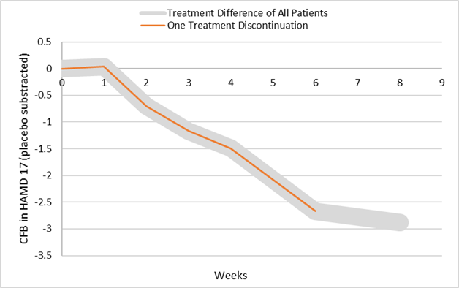
Clinical Questions Related to Category 1 ICE
discontinued due to AE, no additional treatment between Weeks 6 and 8
Clinical questions:
What is the observed treatment effect for the patient at Week 8?
If the patient did not experience AE discontinue the treatment, what is the expected treatment effect at Week 8? (problematic)

Slide 33
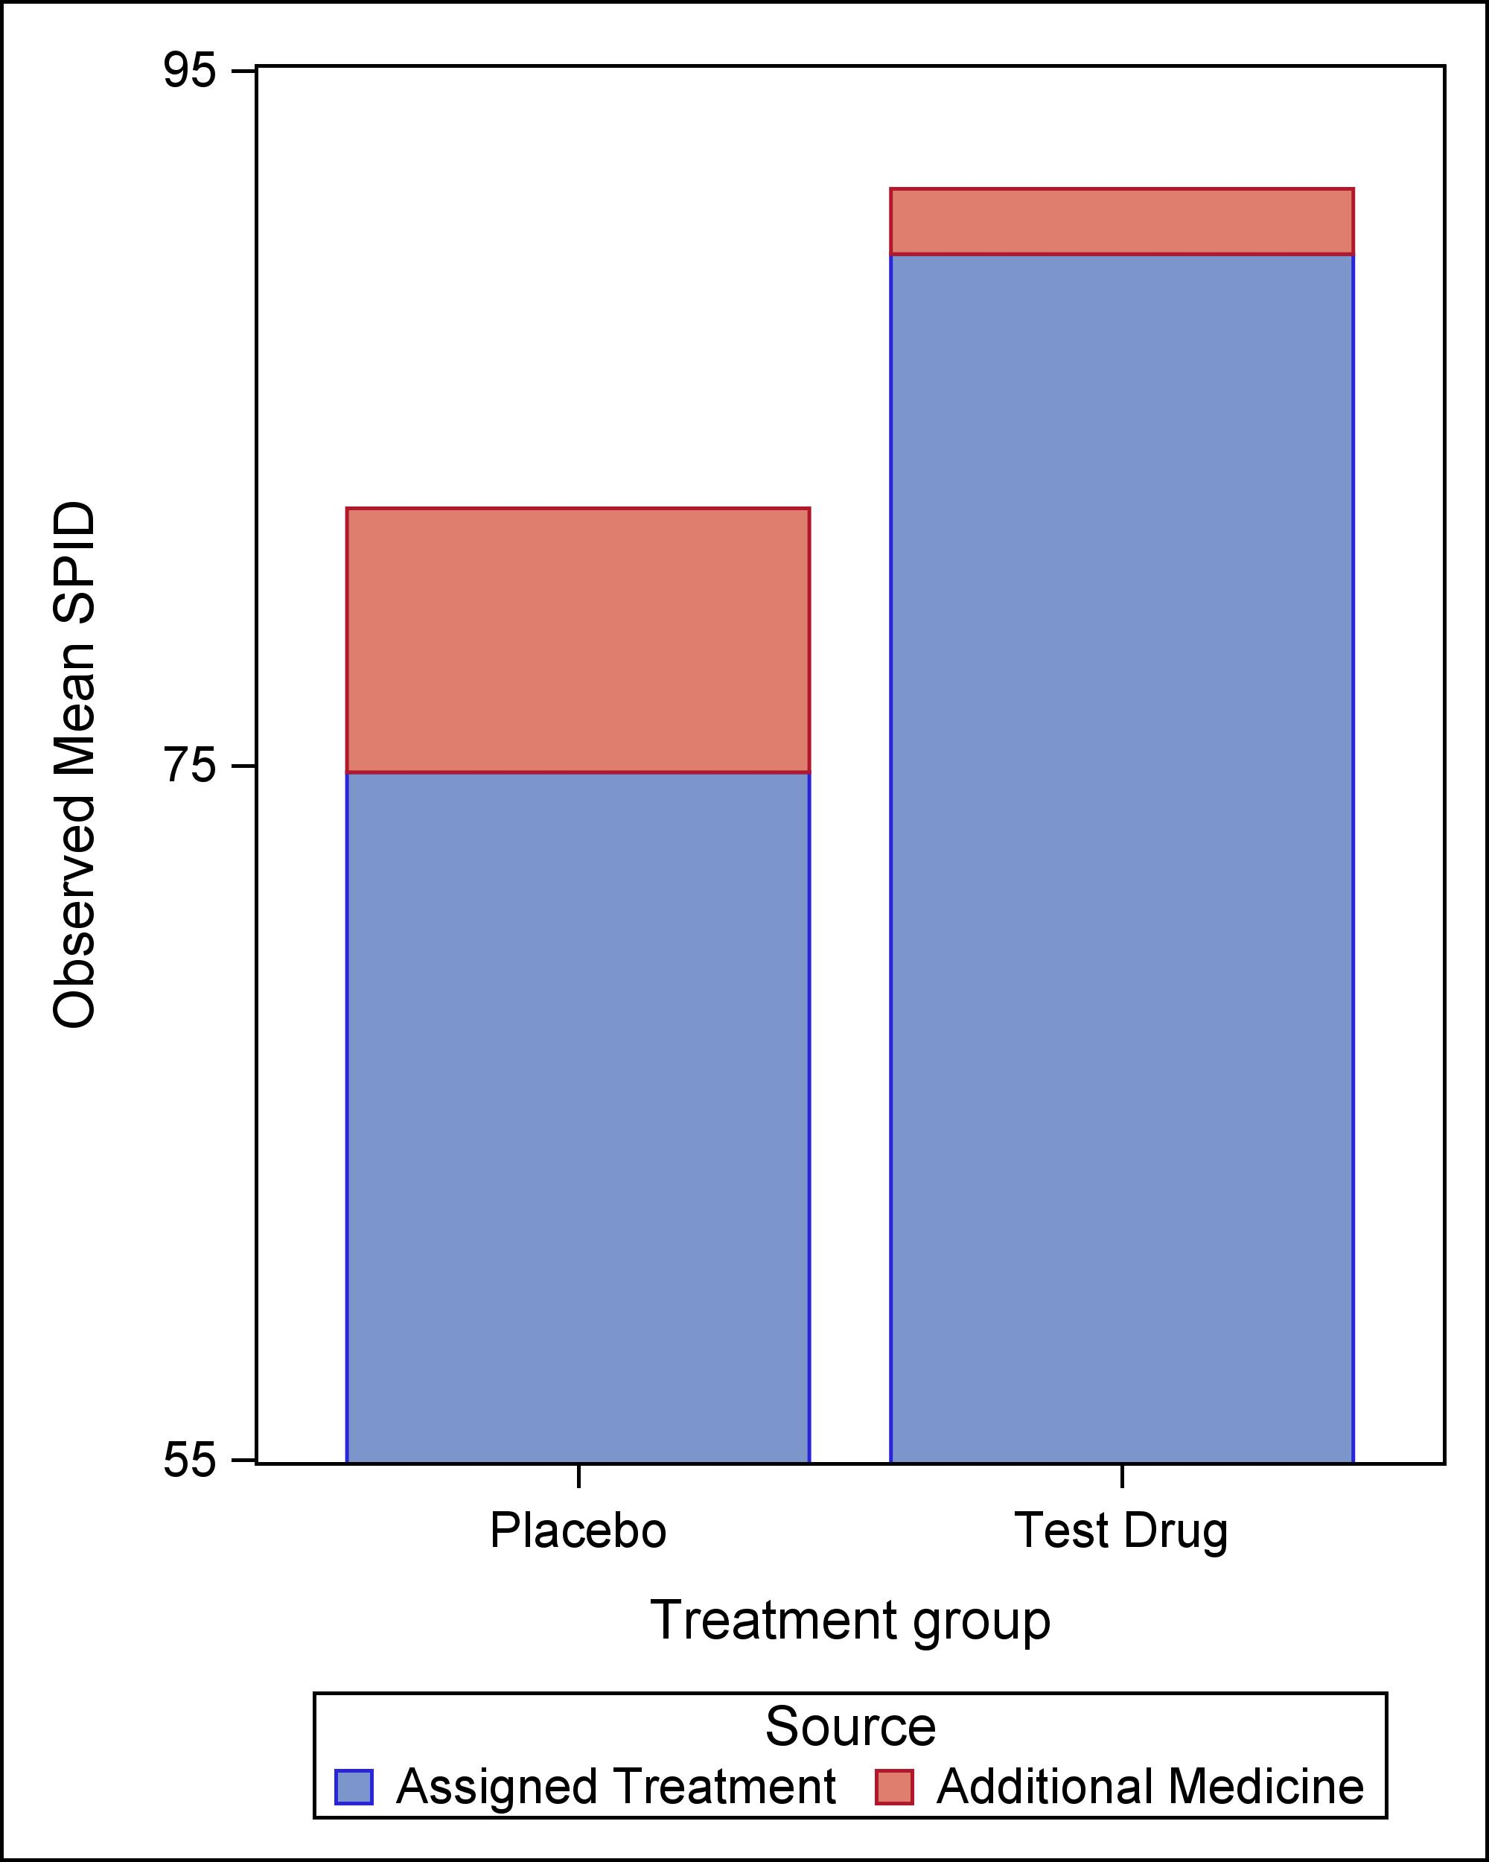
Clinical Questions Related to Category 2 ICEs
The observed effect is a combined effect of treatment and Intervention.
Clinical questions:
What is the combined effect of treatment and Intervention?
What is the effect due to the treatment?
Do we have to ask “what is the treatment effect had the intervention not occurred?”
In nonrandomized studies, we ask “what is the average treatment effect (ATE)?”; we do not ask ““what is ATE had the confounding not occurred?”

Slide 34
Hypothetical Strategies
Answer questions
What is the treatment effect if patients did not experience category 1 ICEs (which are direct consequences of the treatment)
What is the effect of treatment (separated from the intervention) when some patients experience category 2 ICEs (interventions)?
Challenges in clinical justification
The hypothetical scenario of “if all patients can tolerate the treatments” is clearly problematic because tolerability is an intrinsic characteristic of the treatment
All hypothetical scenarios of “intercurrent event would not occur” can be challenging too
Challenges in providing estimation: not all data observable

Slide 35
Alternative Strategy 1: Treatment Policy Strategy
The occurrence of the intercurrent event is considered irrelevant
The treatment effect is not the same one that is aimed by hypothetical strategies
Data not collected after ICE are missing; Can be problematic in NI trials if used to address Category 2 ICEs.
Example: Oncology trials continue to follow patients for PFS/OS after patients discontinue treatments due to AE
If patients‘ data are not collected, we need to imagine the outcome under the hypothetical scenarios if they were followed

Slide 36
Alternative Strategy 2: Composite Variable Strategies
Intercurrent event is incorporated into the definition of the endpoint.
Could be good alternatives to hypothetical strategies for category 2 ICEs and answer the question “what is the effect due to the treatment”?
Change endpoint: different components may be of different importance
Example: In HIV trials, treatment discontinuations due to AEs are considered virologic failures.
Because we assume that patients will loss control of viral loads after the treatment discontinuation if they do not take additional treatments.

Slide 37
Other Alternative Strategies for Modified Questions
Problematic: What is the treatment effect if all patients can tolerate the treatments?
Revised: What is the treatment effect in patients who can tolerate the treatments?
This is the treatment effect for “tolerators”
The subpopulation “who can tolerate the treatments” is not clearly defined, as it depends on treatment and control
Potential solutions to target two different ‘tolerators’:
Principal stratum strategies
Randomized withdrawal trial design

Slide 38
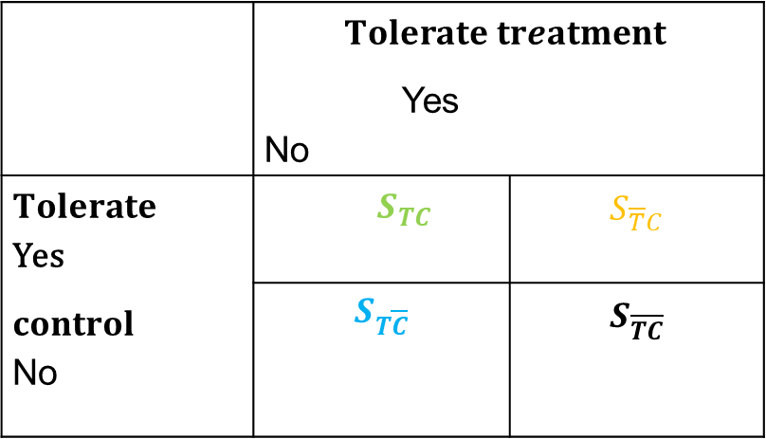
Defining Populations of “Who Can Tolerate the Treatments”: Principal Stratum
 | $$Tolerate treatment$$ Yes No
$Tolerate$ Yes $control$ No | ${ S}_{TC}$ | $$S_{\overline{T}C}$$
 | $$S_{T\overline{C}}$$ | $$S_{\overline{TC}}$$
Patients who tolerate treatment: ${ S}_{TC}$ plus $S_{T\overline{C}}$
Patients who tolerate control$: { S}_{TC}$ plus${ S}_{\overline{T}C}$

Slide 39
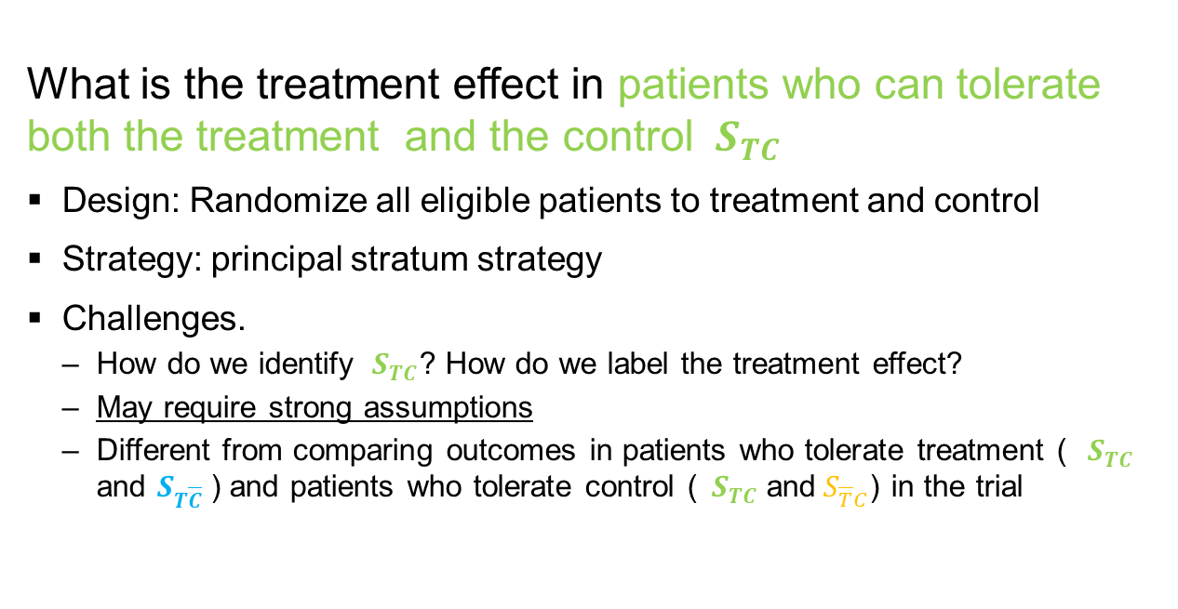
Revision 1 of Treatment Effect in Always Tolerators
What is the treatment effect in patients who can tolerate both the treatment and the control ${ S}_{TC}$
Design: Randomize all eligible patients to treatment and control
Strategy: principal stratum strategy
Challenges.
How do we identify ${ S}_{TC}$? How do we label the treatment effect?
May require strong assumptions
Different from comparing outcomes in patients who tolerate treatment (${ S}_{TC}$ and $S_{T\overline{C}}$) and patients who tolerate control (${ S}_{TC}$ and${ S}_{\overline{T}C}$) in the trial

Slide 40
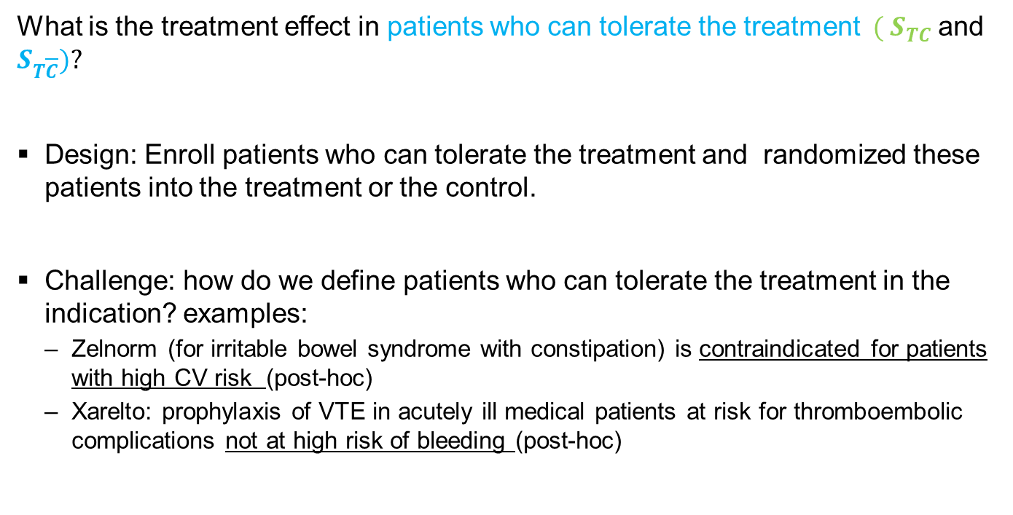
Revision 2 of Treatment Effect in Treatment Tolerators
What is the treatment effect in patients who can tolerate the treatment$({ S}_{TC}$ and $S_{T\overline{C}})?$
Design: Enroll patients who can tolerate the treatment and randomized these patients into the treatment or the control.
Challenge: how do we define patients who can tolerate the treatment in the indication? examples:
Zelnorm (for irritable bowel syndrome with constipation) is contraindicated for patients with high CV risk (post-hoc)
Xarelto: prophylaxis of VTE in acutely ill medical patients at risk for thromboembolic complications not at high risk of bleeding (post-hoc)

Slide 41
An Example of Randomized Withdrawal Designs
Drug: Rifaximin
Indication: Treatment of irritable bowel syndrome with diarrhea
Two typical randomized placebo-controlled short-term (14 days) trials
One additional randomized-withdrawal trial to study long-term effect
Reference: https://www.accessdata.fda.gov/drugsatfda_docs/label/2020/021361s025lbl.pdf

Slide 42
Estimation
A hypothetical scenario in which the intercurrent event would not occur: the value of the variable is the value which the variable would have taken in the hypothetical scenario
Determining the “unobservable” value needs assumptions:
Is the assumption realistic?
Are the results sensitive to the assumption?

Slide 43
Drug-Specific Guidance on the Importance of Reliable Estimation
EMA Guideline on treatment of Alzheimer’s disease
“providing that reliable methods of estimation can be identified; an appropriate target of estimation could be based on a hypothetical scenario in which the new concomitant medication or modifications in the dose of concomitant medications had not been introduced.”
EMA Guideline treatment or prevention of diabetes
“treatment effect can be estimated under the assumption that rescue medication or use of other medications that will influence HbA1c values, was not introduced, provided that a reliable estimate of that effect can be obtained.”
FDA Guidance for Industry. Acute Myeloid Leukemia: Developing Drugs and Biological Products for Treatment.
hypothetical strategy was currently not recommended for the primary analysis to address the influence of hematopoietic stem cell transplantation because it may not be possible to design a clinical trial to estimate the treatment effect defined by the hypothetical strategy

Slide 44
Examples on Estimation Methods Handling Treatment Switch
In oncology trials, patients may switch treatment after disease progression. Estimation of effect in OS relies on strong assumptions
Rank Preserving Structural Failure Time Model, assuming that treatment effect is equal for all patients regardless the time when the treatment is received
Inverse Probability of Censoring Weights: no unmeasured confounders
EMA “Question and answer on adjustment for cross-over in estimating effects in oncology trials”. recommends against those hypothetical strategy causal inference methods that rely on very strong assumptions

Slide 45
Criteria to Select Estimand Strategies
Whether clinical questions are of clinical and regulatory importance or interest;
Whether a reliable estimator can be provided with appropriate sensitivity analyses
Question to consider: Does ICH E9 (R1) really anticipate we can only select among the 5 strategies?

Slide 46
Gaps between Clinical Questions of Interest and Estimand Strategies
Gaps: Some clinical questions are of interest. But it is hard to addressed them by any of the 5 estimand strategies as defined.
Some question we discussed earlier
Question about a maintenance therapy, recognizing that patients who discontinued the therapy would not have long term effect (e.g. long term health condition will be like the condition at baseline)?
How do we close these gaps?
Should we describe the treatment effect without creating the hypothetical scenarios if possible?
Should we expand the definition of hypothetical strategies?
Should we explore additional estimand strategies?

Slide 47
Summary
Hypothetical strategies
Aim to estimate drug effects
Challenges in clinical justification and in estimation with the current definition
Alternatives:
Composite variable strategies: endpoints are changed
Treatment policy strategy: clinical questions are changed
Randomized withdrawal design: challenging to interpret and label the treatment effect
Principal stratum strategies challenging to interpret and label the treatment effect
Gaps and challenges remain, collaboration
to close the gaps between clinical questions of interest and estimand strategies
to address estimation problems including sensitivity analyses through innovations.

Slide 48
Summary
Hypothetical strategies
Aim to estimate drug effects
Challenges in clinical justification and in estimation with the current definition
Alternatives:
Composite variable strategies: endpoints are changed
Treatment policy strategy: clinical questions are changed
Randomized withdrawal design: challenging to interpret and label the treatment effect
Principal stratum strategies challenging to interpret and label the treatment effect
Gaps and challenges remain, collaboration
to close the gaps between clinical questions of interest and estimand strategies
to address estimation problems including sensitivity analyses through innovations.
Thank you!

